Slide 1
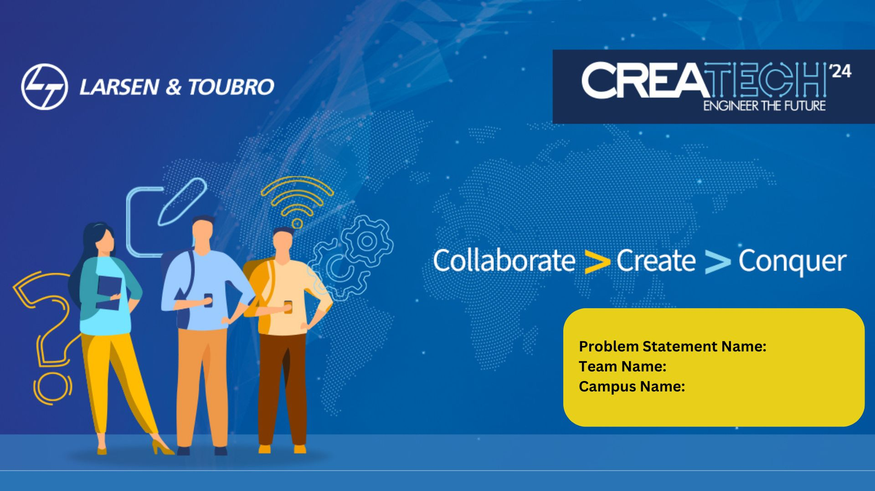
Problem Statement: Design architecture for a multilingual automation system using Google Assistant and Raspberry Pi for Level & Pressure Control System.
IITTP
IIT Tirupati
Team Name: IITTP
Campus Name: IIT Tirupati

Slide 2
Problem Definition
The existing systems are not very robust. The pressure and level setpoints are supposed to be set manually in the current systems. Our solution comprises of: Remote management, Linguistic diversity, resource management, visualization and serialization of data.
Goals and Objectives
Our objective is to make a robust system which can be used by workers of any region across the globe, with ease, to control the level and pressure of a tank using voice.
Assumptions/Constrains
The compressor is a variable compressor instead on an on/off one. Water level sensor is such that it is not affected by change in density or the substance inside the tank.

Slide 3
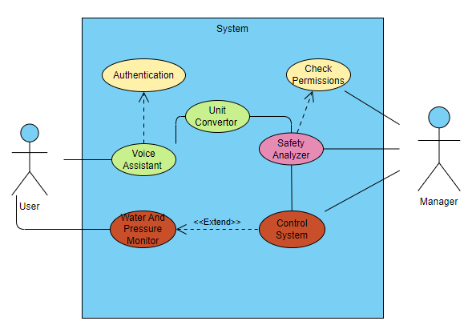
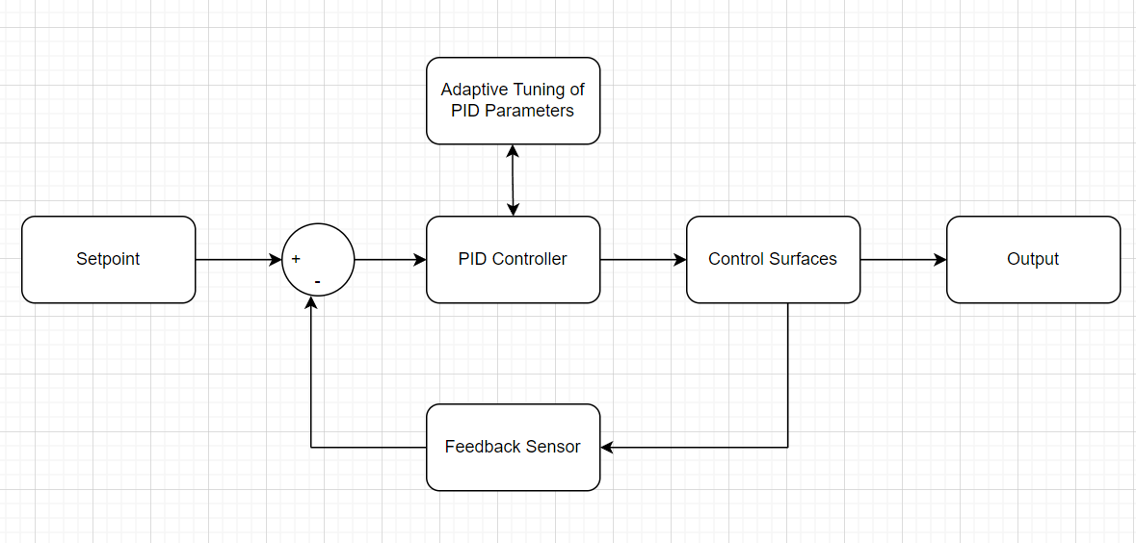
Architecture of the system
UML Use-case
Control System Architecture

Slide 4
Novelty of Approach
Adaptive PID Tuning
Transparent AI
Priority based functions
Version Control
Automatic Pressure Hash Map
Impact
Compatibility
Usability -> New and existing pressurised tanks
Reduced Resource Requirement –> System Modelling not required
Multilingual
Skilled workers can be employed regardless of their linguistic capabilities
Reduces human error as system works in first language of user and Unit Convertor is defined implicitly
Reduced Rate of Failures
Code makes sure to confirm at multiple points, the inputs of user
For critical values or crucial parameters, operators with special permissions can only make changes.
System Optimizations -> Increase over time.
Detailed log and Shift to preset is available

Slide 5

Thank you

